Slide 1
Do you sometimes feel like you care too much?
Understanding compassion fatigue for animal care providers
Phyllis Erdman, Ph.D. College of Education

Slide 2
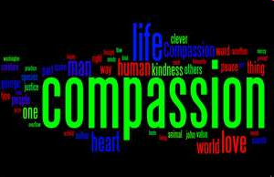
Sometimes when we care too much,
we experience compassion fatigue (CF)

Slide 3
What is Compassion Fatigue (CF)?
Weariness brought about by repetitive, empathic response to pain
Gradual lessening of compassion over time
Taking on others’ suffering
Both a blessing and a curse

Slide 4
Compassion Fatigue and the Professions
Healthcare Professions
  Physicians, Nursing, Social Services, Mental Health Providers, Veterinarians, Veterinary Teams
Other Helping Professions
  Teachers, Clergy, Attorneys, Disaster Site Clean-up Crews, Animal Shelter, IACUC members/staff, animal facility managers
Fire, EMS, Law Enforcement
Family Care Givers
Animal rescue workers/Animal Caregivers

Slide 5
Normal or Abnormal
“The expectation that we can be immersed in suffering and loss daily and not be touched by it is as unrealistic as expecting to be able to walk through water without getting wet”
Remen, 1996

Slide 6
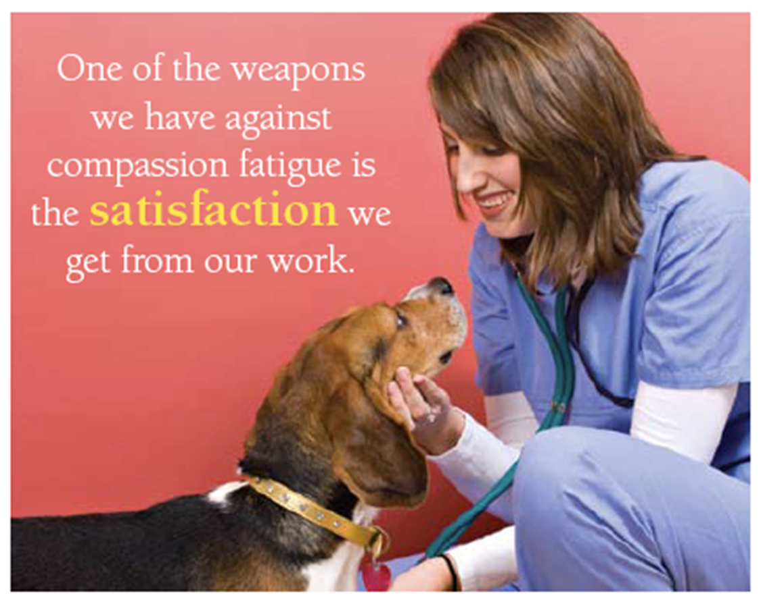

Slide 7


Burnout vs. Compassion Fatigue
Burnout stems from dissatisfaction from the work environment.
Compassion Fatigue stems from absorbing the suffering of your clients or patients.

Slide 8
The Difference?
Ask yourself:
“Do I Love My Job?”
No
Burnout
Yes
Compassion
Fatigue

Slide 9

Misperceptions that lead to CF
“I will ‘fix’ the problem…make everything OK…save the world.”
“ I am responsible for outcomes.”
“If I care enough, everything will be OK.”
The hurting people/animals I help will appreciate everything I do for them.”

Slide 10
What We See with CF
Sleeping problems or nightmares
Intrusive thoughts, memories and flashbacks
Hyper-vigilance
General anxiety and anxiety attacks
Isolation and disconnection
Substance abuse and high risk behaviors
Changes in appetite and sex drive
Irritability and depression
Cynicism, negativity, and apathy about life and the world
Substandard level of care
Increased cynicism

Slide 11
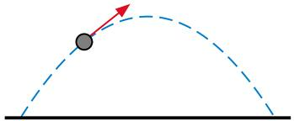
The Compassion Fatigue Trajectory
1. ZEALOT PHASE
2. IRRITABILITY PHASE
3. WITHDRAWAL PHASE
4. ZOMBIE PHASE
5. VICTIMIZATION

Slide 12

ZEALOT PHASE
  Committed, involved, available
  Solving problems/making a difference
  Willing to go the extra mile
  High enthusiasm
  Volunteers without being asked
  May be called an Idealist

Slide 13

IRRITABILITY PHASE
Begin to cut corners
Begin to avoid tasks involving animals
Begin to mock co-workers and clients
Begin to denigrate the people they serve
Use inappropriate/dark humor
Make mistakes
Distance selves from friends & co-workers

Slide 14


WITHDRAWAL PHASE
Enthusiasm turns sour
Animals become problems, not concerns
We make complaints about our work life
and our personal life
Tired all the time
Neglect family, animals, coworkers and ourselves
Try to avoid our pain and sadness

Slide 15

ZOMBIE PHASE
Hopelessness turns to rage
Feel like you’re on auto pilot
Judge others as incompetent or ignorant
Develop a disdain for everyone
Lose patience, sense of humor, time for fun
Possibly experience health problems

Slide 16


VICTIMIZATION PHASE –
Do or Die
Become overwhelmed/leave profession
Feel helpless and hopeless
Have perpetual/chronic symptoms
Shut down/depressed/ suicidal
OR
Transform your approach and build resiliency
Commit to career

Slide 17
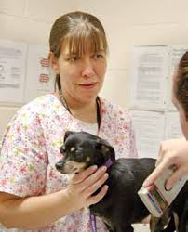
Who is More Likely to Develop CF?
People who:
Have capacity for true compassion, empathy, concern and caring
Lack of social resources/support
By nature, lower emotional resiliency
Bound by rules/obligations

Slide 18


What You Can Do
Recognize the symptoms
Educate yourself
Recognize contributors:
  Prolonged exposure
  Working long hours
  Excess personal demands
  Personal Isolation

Slide 19

How can you prevent alleviate CF?
Early recognition and awareness
Restore a healthy balance in your life
Enhance self care skills

Slide 20
How do you bring your caring and giving nature back into focus?
1. Reframing
2. Rethinking

Slide 21
Reframing
Recognize that you are a hero doing some of the most difficult and most important work for animals.
Honor yourself and feel proud of the difference you are making.
Know and recognize that you are an active part of the solution.

Slide 22
Rethinking
Think about "why" you’re so dedicated to helping animals (e.g., what is the personal meaning?)
Think about whether you put the animals’ welfare before your own.
Realize that you need to take care of yourself first or you’ll have nothing left to give to the animals.

Slide 23
How does CF impact us?
Physical needs
Mental needs
Occupational needs
Relational needs
Spiritual needs

Slide 24

Physical Needs
  Seek medical treatment for symptoms that interfere with daily functioning
  Eat meals at a relaxed pace
  Develop breathing exercises to calm you
  Find a quiet place (emotionally and physically
  Develop and stick to an exercise plan
  Don’t self-medicate with alcohol or drugs
  Take time off!

Slide 25
Mental Needs
  Assess what’s on your plate
  Make a list of your stressors to see what is making your plate too full
  Try to reduce or eliminate multi-tasking
  Identify stressful thinking (e.g. “always,” “never” “should” “ought”)
  Reframe failures as mistakes and learning opportunities

Slide 26
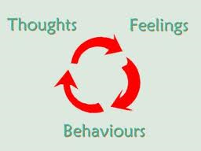
  Notice the connection between thoughts, feelings and behaviors

Slide 27
Occupational Needs
  Assess your current job and work environment
  Ask yourself :
    Does your work fit your interests?
    Are you passionate about your work? Do you love what you do?
    Does it allow you to use all of your strengths?
    Does it allow you sufficient leisure time?

Slide 28

Relational
  Create a self-care plan (e.g., walk on the beach, massage, watching sports on TV)
  Plan time to connect with family and friends
  Keep a feelings journal
  Have one good conversation a day
  Find someone who cares – You will
  be surprised!

Slide 29

Spiritual
Practice prayer or meditation
Practice intentional silence
Listen to music
Read uplifting material

Slide 30
How to address CF at work
Rebalance your workload to avoid working through lunch and weekends
Take mini-breaks
Find at least one fun and nourishing activity a day
Ask for help
Have a transition from work to home

Slide 31

  Learn to say “no” more often.
  Create and/or enforce time off policies in the workplace!
  Remember -- A dry well cannot quench thirst!

Slide 32
Suggested Coping Strategies
Escape:
Get away from it all, physically or mentally
Rest:
Try to have no goal or time-line, and do things you find relaxing
Play:
Engage in activities that make you laugh or lighten your spirits

Slide 33

Just as speech without silence creates noise, charity without rest creates suffering.
(Muller, 1999)

Slide 34
Help for students
Cougar Health Services
https://cougarhealth.wsu.edu/your-first-visit/
College of Veterinary Medicine
Counseling and Wellness
https://www.vetmed.wsu.edu/academic-programs/counseling-wellness

Slide 35
Help for faculty/staff
Employee Assistance Program (EAP)
https://hrs.wsu.edu/resources/employee-assistance-program/
Palouse River Counseling
509- 334-1133

Slide 36

Questions?

Slide 37
References
Figley, C. (1995). Compassion Fatigue: Coping with secondary traumatic stress disorder in those who treat the traumatized. London: Brunner-Routledge.
Mitchener, Oglivie, (2002). Understanding compassion fatigue: Keys for the caring veterinary healthcare team. Journal of the American Animal Hospital Association, 38 (4),
Muller, W. (1999). Sabbath: Restoring the sacred rhythm of rest. NY: Bantam.
Newsome, Clemmons, Fitzhugh, Gluckman, Creamer-Hente, Tambrallo, Wilder-Kofie (2019). Compassion fatigue, euthanasia stress, and their management in laboratory animal research. Journal of the American Association for Laboratory Animal Science, 59 (3), 289-292.

